Slide 1
Visualizing Textual Data
With HathiTrust+Bookworm and Voyant Tools
Eleanor Dickson and Harriett Green
University of Illinois at Urbana-Champaign

Slide 2
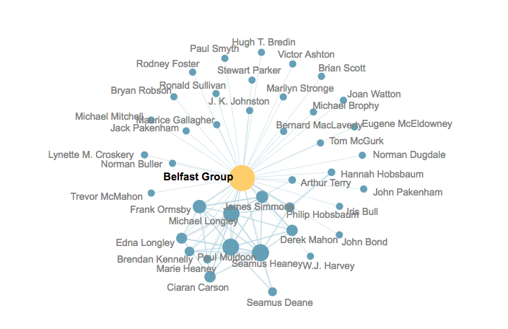
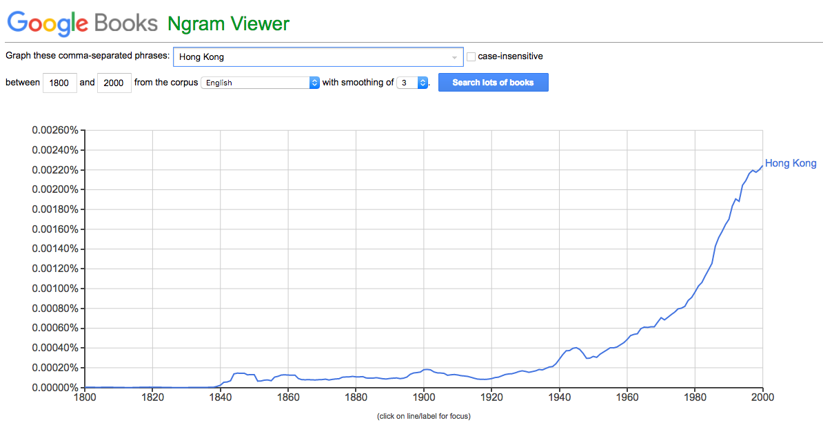
Aid analysis
Especially for large datasets
https://books.google.com/ngrams/
http://belfastgroup.digitalscholarship.emory.edu/network/belfast-group/

Slide 3
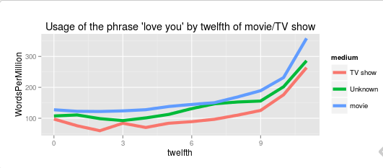
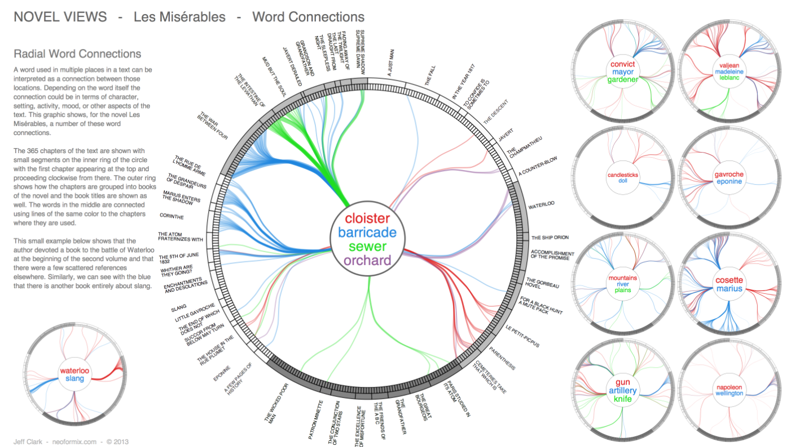
Present results
Accompany publication or other dissemination
http://sappingattention.blogspot.com/2014/12/fundamental-plot-arcs-seen-through.html
http://www.neoformix.com/2013/NovelViews14_l.png

Slide 4
HathiTrust+Bookworm
Visualize Lexical Trends

Slide 5
HT
HathiTrust
Text data
Bibliographic metadata
BW
Bookworm
Visualization tool
Track trends in a repository
+
Funded by the National Endowment for the Humanities
Notes:
Bookworm is a tool that visualizes language usage trends in repositories of digitized texts in a simple and powerful way. It is a tool that facilitates the observation of chronological trends for words and phrases in large digitized collections of textual documents with metadata facets.
HathiTrust + Bookworm is a visualization of word frequencies over time in the HathiTrust Digital Library.
There are other Bookworms that exist, like this one for the preprint service arXive: http://bookworm.culturomics.org/arxiv/

Slide 6
Bookworm philosophy
Normal search engines are good at finding individual texts
Bookworm is good at representing categories
The category is plotted along the x-axis
Standard view: years
Could also show: languages, etc
Adapted from Ben Schmidt, “Bookworm API Philosophy”
Notes:
Normal search engines are very good at finding individual texts: Bookworm is good at finding and understanding categories in a library.
The simplest use case is returning usage of a word across years: the goal here is to understand something about the years through the words they use.
The category can also be defined by ordinals instead of cardinals.

Slide 7
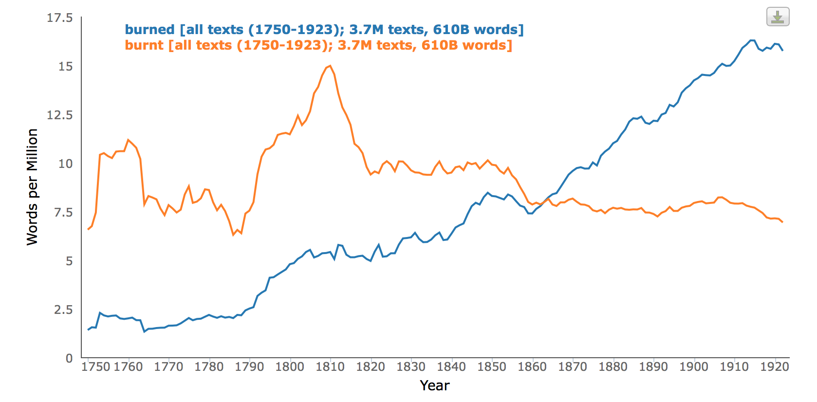
Research with HT+BW
Researched by Erez Lieberman Aiden
Co-creator of Google Books Ngram Viewer
Partner in the HathiTrust+Bookworm project
Showed how irregular verbs tend to become regular over time
Called this approach: Culturomics
Notes:
To quantify the dynamics of language evolution, Aiden et al. studied the regularization of English verbs over hundreds of years. His group originally conducted a manual study first and published the results in Nature in 2007, and then proceeded to study this phenomenon further using computational methods in 2007.
They called this approach as Culturomics, defined as “the application of high-throughput data collection and analysis to the study of human culture”.
Link to 2010 Science article:
https://18b5b38b-a-1b47af26-s-sites.googlegroups.com/a/erez.com/erez/Science%2C%20Culturomics.pdf?attachauth=ANoY7cpiT97pZ-xej_KNWYXB03nwICXeVoHU3KO90UCPxU-Fplr180x8PMg8YjHoTiS_-4ZeYD5NP05lg1GWgPOEBUutv5xR250OI-rC6sSYri5Jgg7QmeZbUy9s2iP7YrslndaCnj7rwCIhA7GnkKEncVUCL1c9CZaJWQ-kWOswN-BtMXMytKEZErp0yiiTEvlqQ5EeO8PMcDcuGakirjDiqf6wKEkF6w%3D%3D&attredirects=0
Link to 2007 Nature article:
https://18b5b38b-a-1b47af26-s-sites.googlegroups.com/a/erez.com/erez/Nature%2C%20Evolution%20of%20Language?attachauth=ANoY7cowP7SwWgU7ZRqLRQAAsPPKcCSC1r1Cg1L3ADSH7pjaINLGhjKQ0XjJOfLNVzLyXh-FH9kPhEY7tEBzYN45HN6qzPeQhTb2wA-TEy0zpk7RXcfiQ4VC6ebWASvieH_39yPavf--zjIbwsneh6iF_4BaUaKs1hsJ0yFlCQ6IhhwOzoDbK26R8l_yT_3CKtyk21vDe3Vv2WE4g0CYIIZRGg-C29chxg%3D%3D&attredirects=0

Slide 8
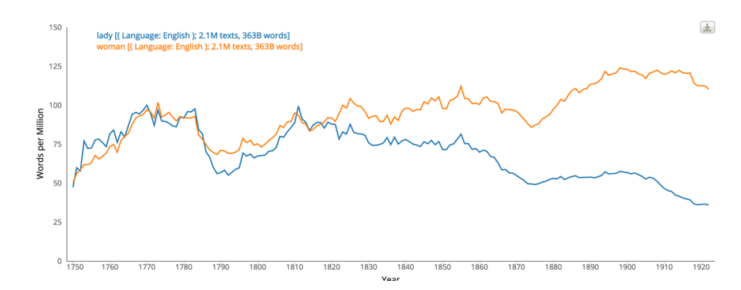
Compare word usage trends
Track social change: lady vs. woman over time
Notes:
Here is an example of how Bookworm can be used to compared word usage trends. In this example, we can see some overall trends in the usage of the word “lady” when compared to that of the word “woman” over the years.

Slide 9
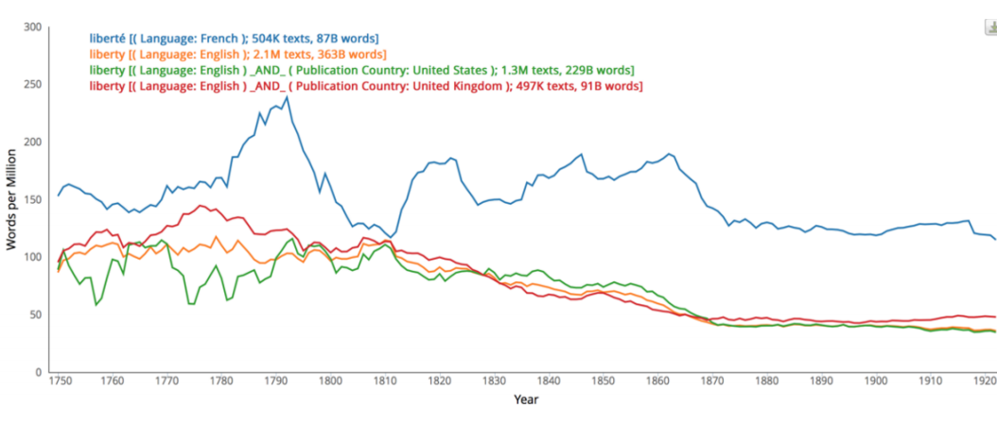
Compare word usage trends
Track words in translation across time and place: liberty and liberté
Notes:
Bookworm can also be useful in tracking words in translation across time and place. In this example, we can visualize how the usage of the French word “liberté” and its English translation “liberty” changed in the texts of their respective languages, as well as changes in the usage of the word “liberty” in English language texts published by two different countries.

Slide 10
Searching
Unigrams
N-gram: unit of text (1 word = 1 gram)
String search
No stemming or lemmatizing
In theory, language neutral
In practice, works best in English because of how n-grams are generated

Slide 11
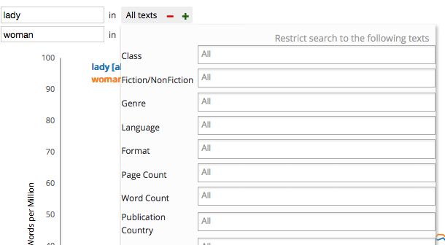
Metadata
Bibliographic metadata
Pulled from library catalog
Allow for faceting
Narrow results
Limit your search
with facets

Slide 12
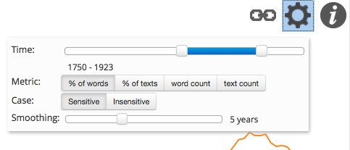
Fine-tuning results
Click on the gear to see more options
Notes:
By clicking on the cog icon on the top right corner of the page, you can also fine-tune your results by controlling the time period, changing metrics, switching between case-sensitive and case-insensitive, and smoothing with different parameter settings.

Slide 13
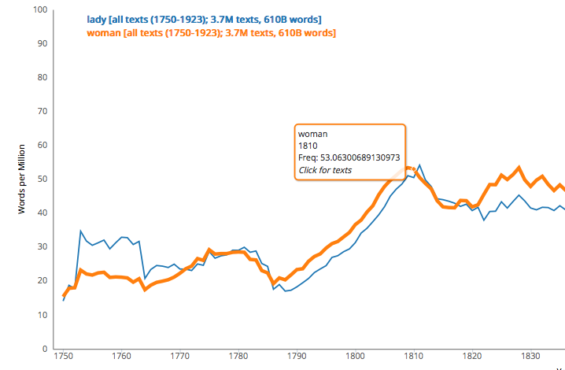
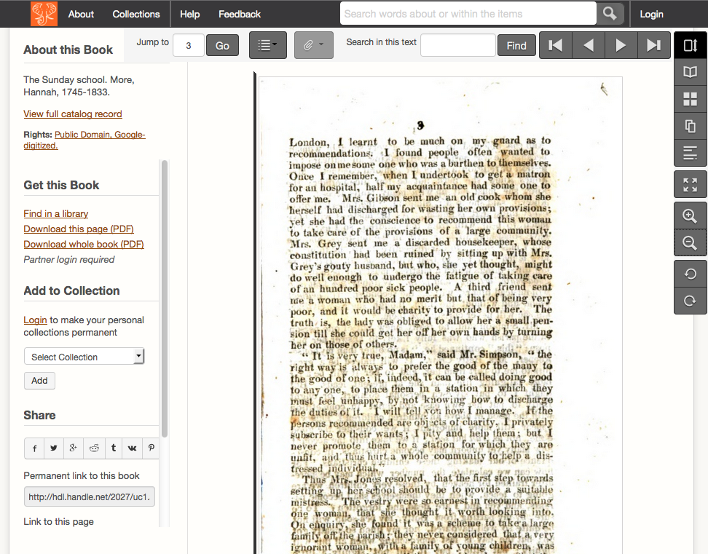
Link directly to texts in the HTDL
Notes:
When you point your cursor to a specific spot on the curve, a window will display the option “click for texts”. Click to be directed to a specific volume in the HathiTrust Digital Library.

Slide 14
Hands-on: Search, facet, and explore
Graph political concepts over time
Socialism vs. fascism Nationalism and internationalism
Graph scientific concepts over time
Vaccine
Electricity
Atom
Or create graphs based on your own interests!
Notes:
HANDS-ON ACTIVITY
Some political examples are: fascism, socialism, nationalism, internationalism.
Scientific examples: vaccine, electricity, atom.
Be creative and feel free to experiment!

Slide 15
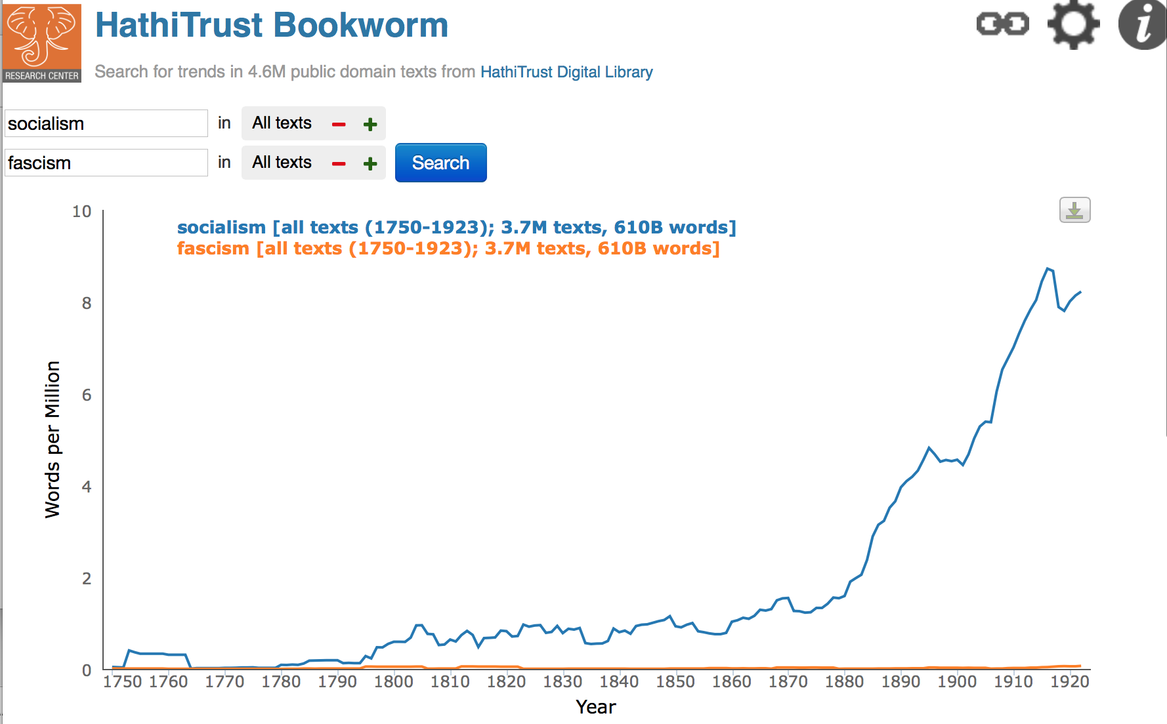
Examples
Notes:
HANDS-ON ACTIVITY
Some political examples are: fascism, socialism, nationalism, internationalism.
Scientific examples: vaccine, electricity, atom.
Be creative and feel free to experiment!

Slide 16
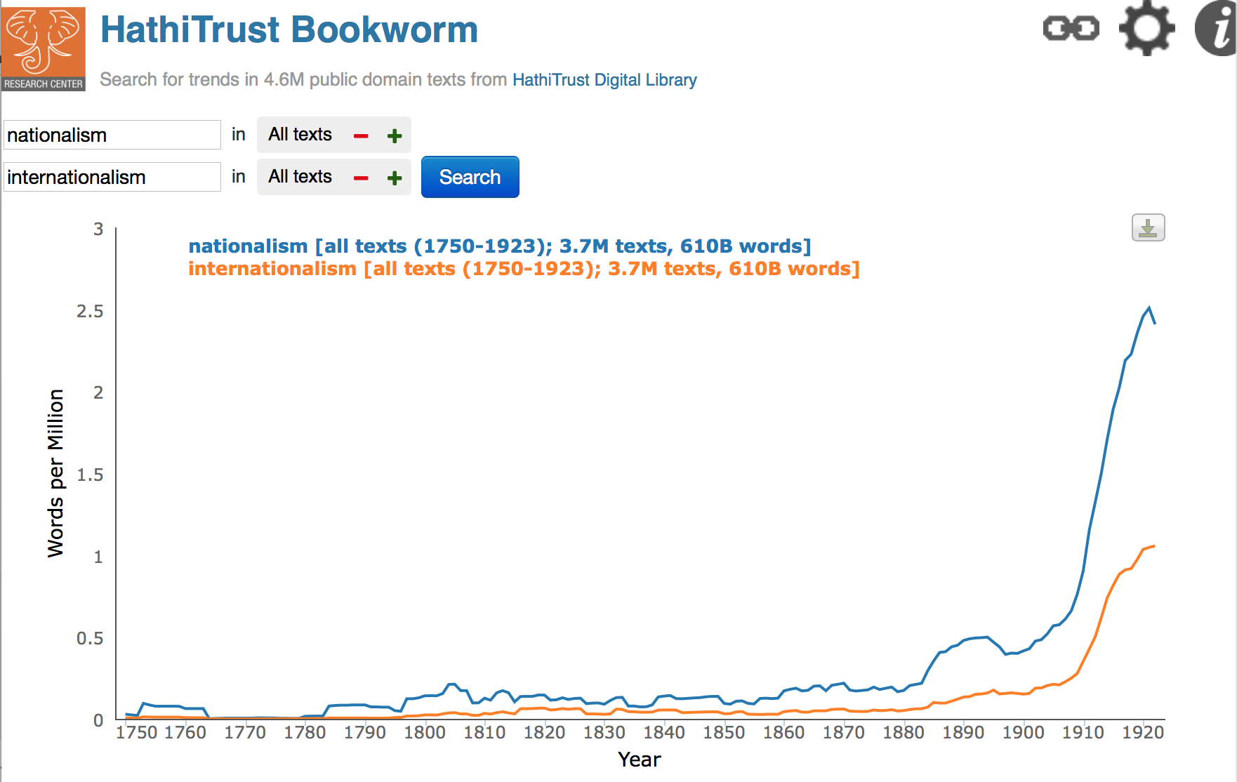
Examples
Notes:
HANDS-ON ACTIVITY
Some political examples are: fascism, socialism, nationalism, internationalism.
Scientific examples: vaccine, electricity, atom.
Be creative and feel free to experiment!

Slide 17
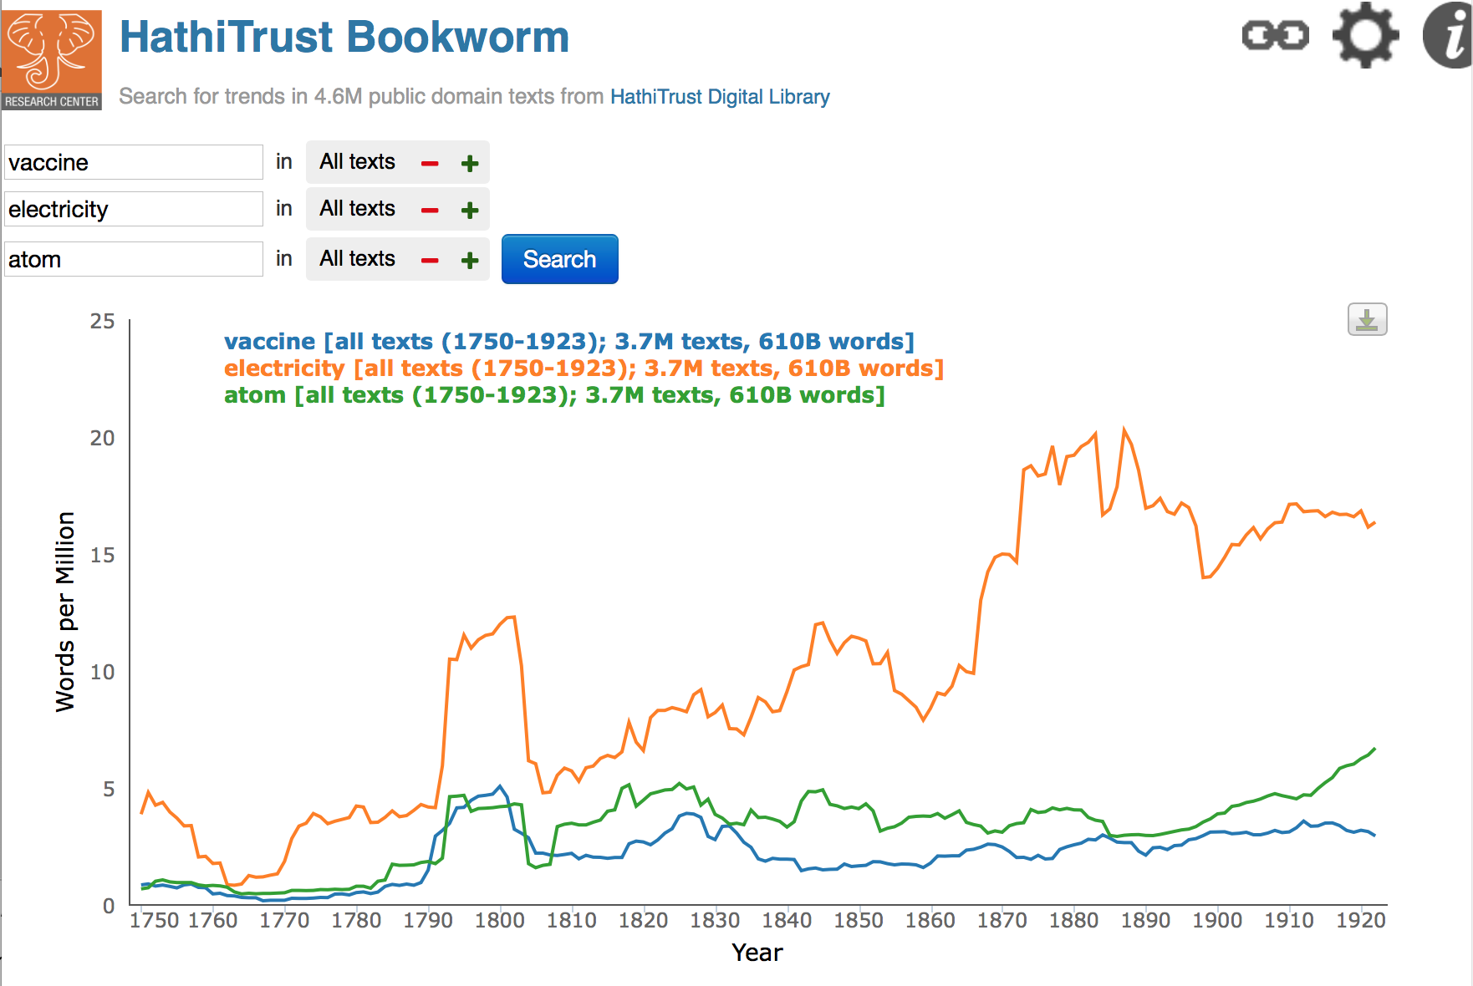
Examples
Notes:
HANDS-ON ACTIVITY
Some political examples are: fascism, socialism, nationalism, internationalism.
Scientific examples: vaccine, electricity, atom.
Be creative and feel free to experiment!

Slide 18
Questions?

Slide 19
Voyant Tools
Quickly visualize text

Slide 20
About Voyant
Developed by Stéfan Sinclair & Geoffrey Rockwell
Web-based tool
Useful for quickly visualizing and analyzing text data
The user imports their own data

Slide 21
Using Voyant: importing text
Import text in many formats
PDF
Microsoft Word
Plain text
URL

Slide 22
Concepts in text analysis
Stop words – frequently used words of little importance to your analysis
Collocations – a specified word shown in the context of its surrounding words
Word cloud - visualization where the most frequently used words are displayed largest

Slide 23
Step 1: Find Texts
Internet Archive: http://archive.org
Digital Public Library of America: http://dp.la
HathiTrust: http://www.hathitrust.org
Project Gutenberg: http://www.projectgutenberg.org
WikiMedia Commons: http://commons.Wikimedia.org
Many libraries, archives, and museums’ online collections
New York Public Library: http://digitalcollections.nypl.org/
British Library Labs: http://labs.bl.uk/Digital+Collections+-+Images

Slide 24
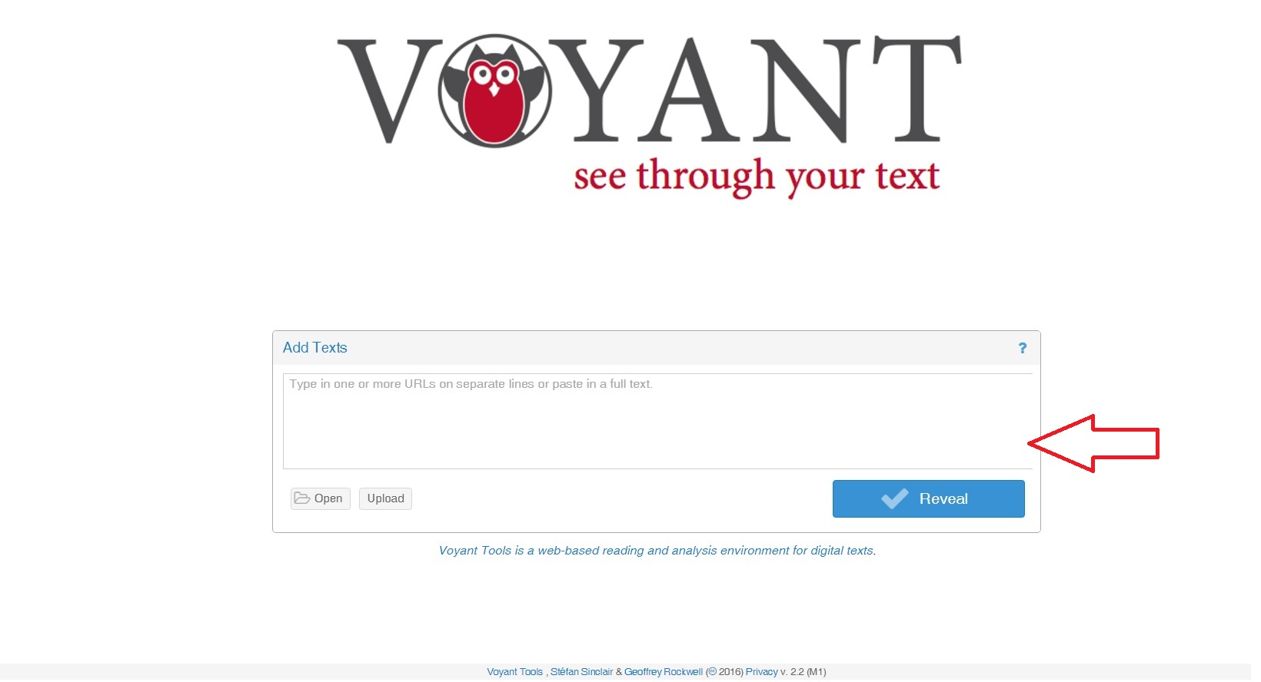
Step 2: Insert text into Voyant
http://voyant-tools.org/

Slide 25
Important Notes
Detects Your Language
Export URL
Export View (visualizations and data)
Pull out segments
Documentation: http://voyant-tools.org/docs/#!/guide

Slide 26
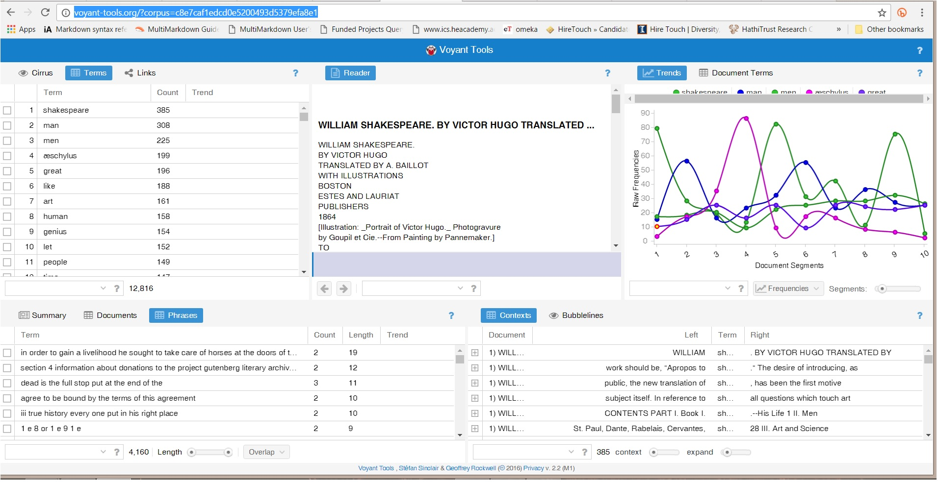
Results in Voyant

Slide 27
Analyze the Text with Voyant Tools
Default view is five tools
Reader: View the text you uploaded into Voyant
Terms: View counts of the most frequently occurring terms
Trends: See what kinds of words occur across the corpus
Phrases: See frequently occurring phrases
Contexts: Provides basic Key Word-In-Context (KWIC) analysis

Slide 28
Tools: Summary, Document, Phrases
The Summary tool will provide information about the text or group of texts including total number of documents and words, length of documents, and distinctive words in each text. This will also draw out notable peaks in frequency and vocabulary density.
The Phrases tool will show common phrases and the frequency of their occurrences.

Slide 29
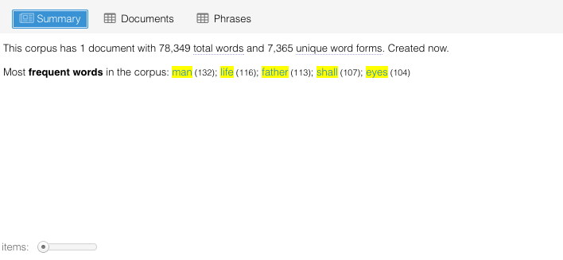
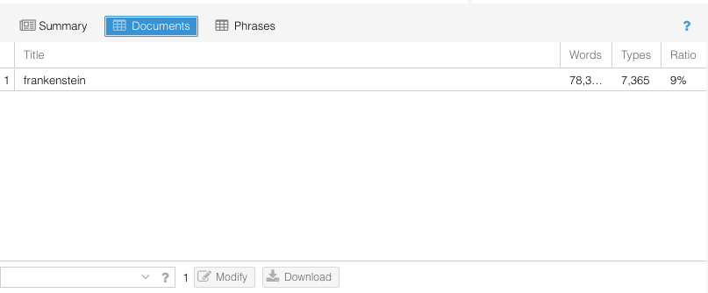
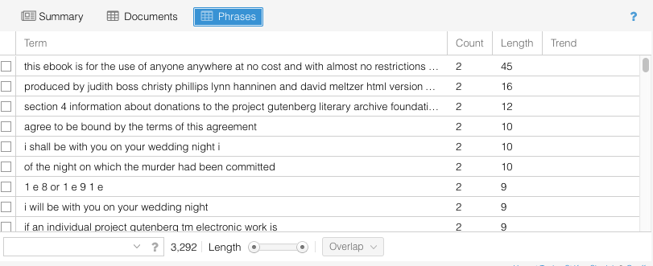
Tools: Summary, Document, Phrases
Summary
Document
Phrases

Slide 30
Tool: Cirrus
Displays a word cloud of highest frequency terms.
Hovering over certain words will reveal their frequency. Clicking on a word will reveal more information including a word trends graph.
To remove articles such as “the” and “and” from the word cloud:
Select the cog tool above the Cirrus feature.
Select the language of the text from the drop down list and then click “Ok.”
This will remove stop words from the word cloud revealing a more meaningful representation.

Slide 31
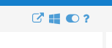
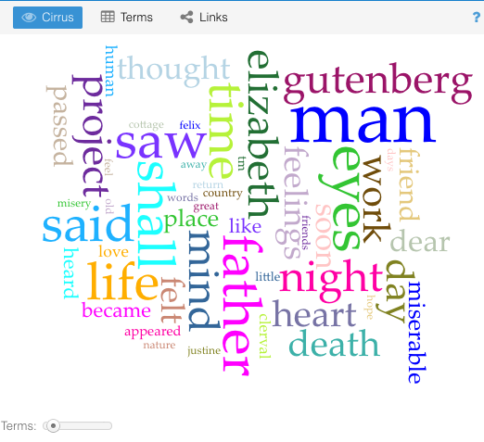
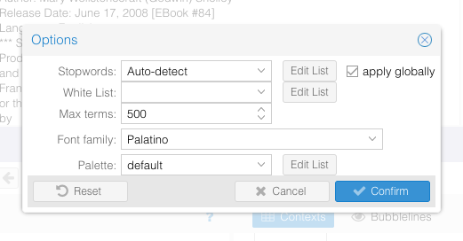
Tool: Cirrus

Slide 32
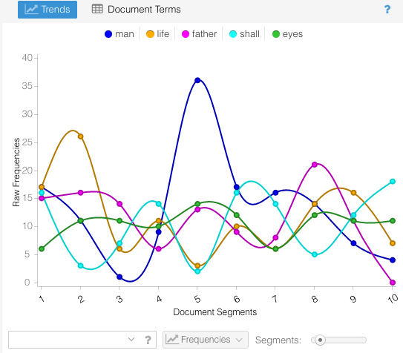
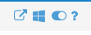
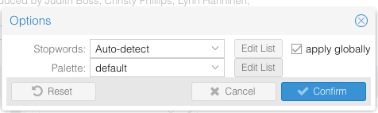
Tools: Trends

Slide 33
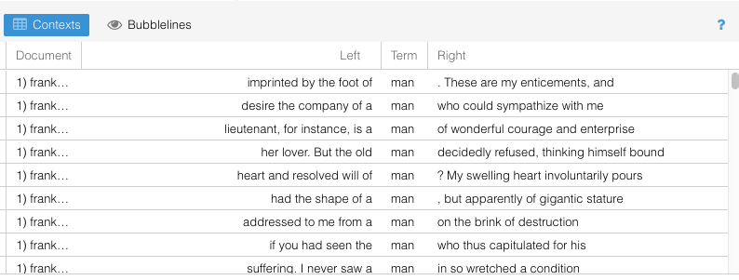
Tools: Contexts

Slide 34
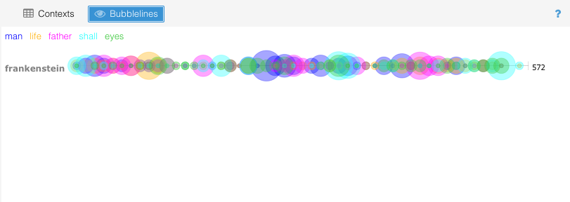
Tools: BubbleLines

Slide 35
You Try It!
Find a text online, or use the file ‘frankenstein.txt’
Upload the text to Voyant: http://voyant-tools.org/
Click “Reveal!” and see your analysis

Slide 36
Thank you and credits
Nicholae Cline and Leanne Nay, Indiana University: Assisted with HT + Bookworm slides from “Digging Deeper, Reaching Further: Libraries Empowering Users to Mine HathiTrust Digital Library Resources” (http://teach.htrc.Illinois.edu)
Anna Trammell, University of Illinois: Former Scholarly Commons GA who created earlier Voyant guide and tool instructions

Slide 37
QUESTIONS?
Eleanor Dickson
dicksone@Illinois.edu
Harriett Green
green19@Illinois.edu
University of Illinois at Urbana-Champaign
http://www.library.Illinois.edu/sc

